Slide 1
Sensation to Perception
The Visual System
A. Kent Van Cleave, Jr., Ph.D.

Slide 2
“Sensory adaptation is the process by which senses become less responsive to particular stimuli” (Editorial Board, 2011, p. 48)
This definition is only half correct, as we will see…
Reference
Editorial Board (2011). Introduction to psychology . Schaumberg, IL:
Words of Wisdom LLC.

Slide 3
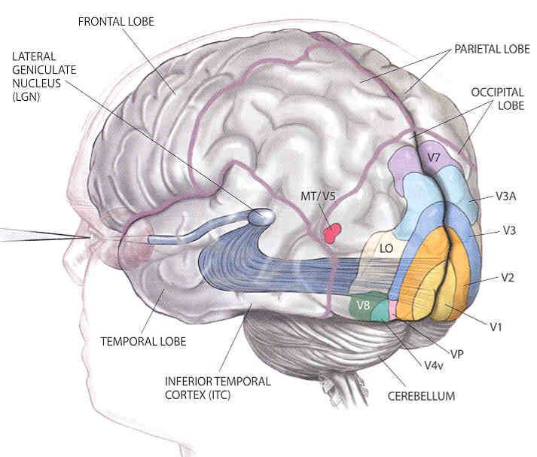
The Human Visual System
Optic nerve
Retina
Visual Cortex
V1, V2…
(ganglion cells)
light

Slide 4
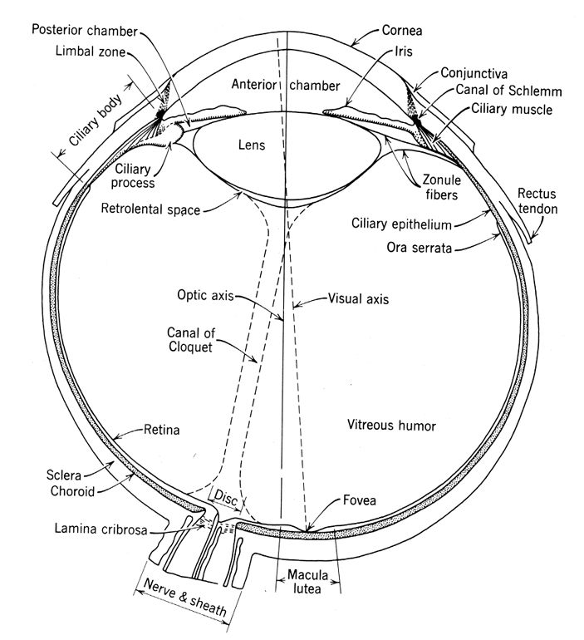
Notes:
Major anatomical structures in the human eye.

Slide 5
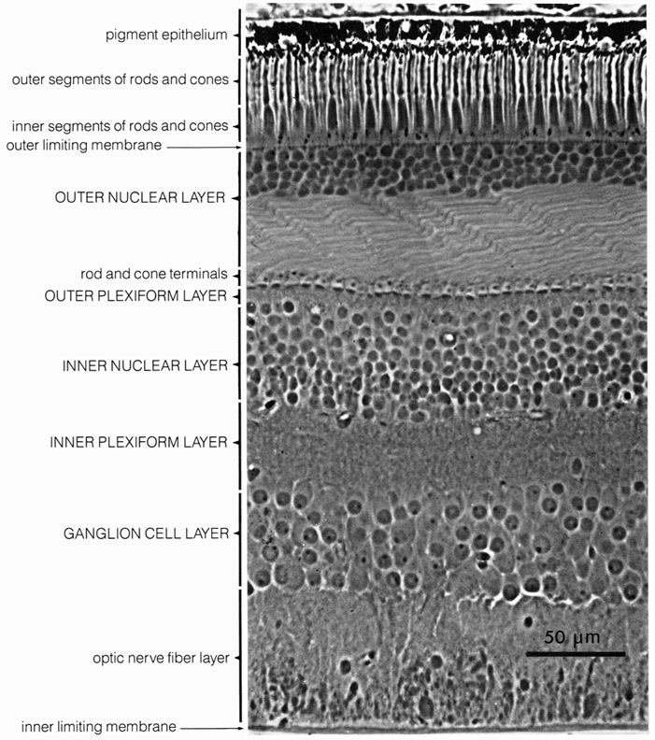
Cross section of the human retina.
The front of the eye is at the bottom.
The rods and cones are at the top – facing backwards!
direction of light
Notes:
Cross section of the human retina. In this figure, light would reach the receptors from below (i.e., through the other cells in the retina). Dowling, J. E. (1987). The Retina: An approachable part of the brain. Cambridge, MA, Belknap Press. Light literally bounces off the back of the eyeball before it hits receptors. Everything we see is a reflection.

Slide 6
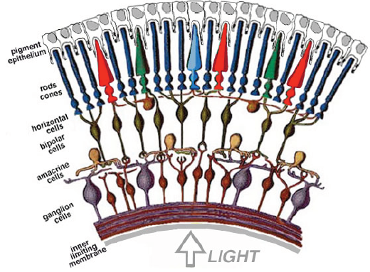
Retina

Slide 7
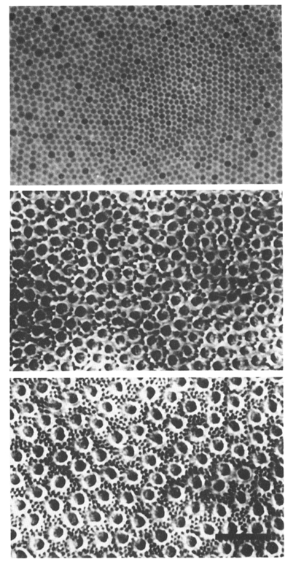
Horizontal sections through the photoreceptor layer.
At 0 deg the cells are all cones.
Small black dots in the sections at 5 deg and 10 deg are rods, the larger cells are cones.
Eccentricity
0°
5°
10°
Notes:
Horizontal sections through the photoreceptor layer at the level of the inner segments, for several eccentricities. Small black dots in the sections at 5 deg and 10 deg are rods, the larger cells are cones. At 0 deg the cells are all cones. For more details see: Curcio, C. A. and K. A. Allen (1990). “Topography of ganglion cells in human retina.” The Journal of Comparative Neurology 300: 5-25. Curcio, C. A., K. R. Sloan, et al. (1990). “Human photoreceptor topography.” The Journal of Comparative Neurology 292: 497-523. Geisler, W. S. and M. S. Banks (1995). Visual Performance. Handbook of Optics. M. Bass. New York, McGraw-Hill. 1: 25.1-25.55

Slide 8
Notes:
Natural light levels cover a very large range, which poses a serious problem for neural coding. These are some of the mechanisms visual systems use to solve the dynamic range problem.

Slide 9
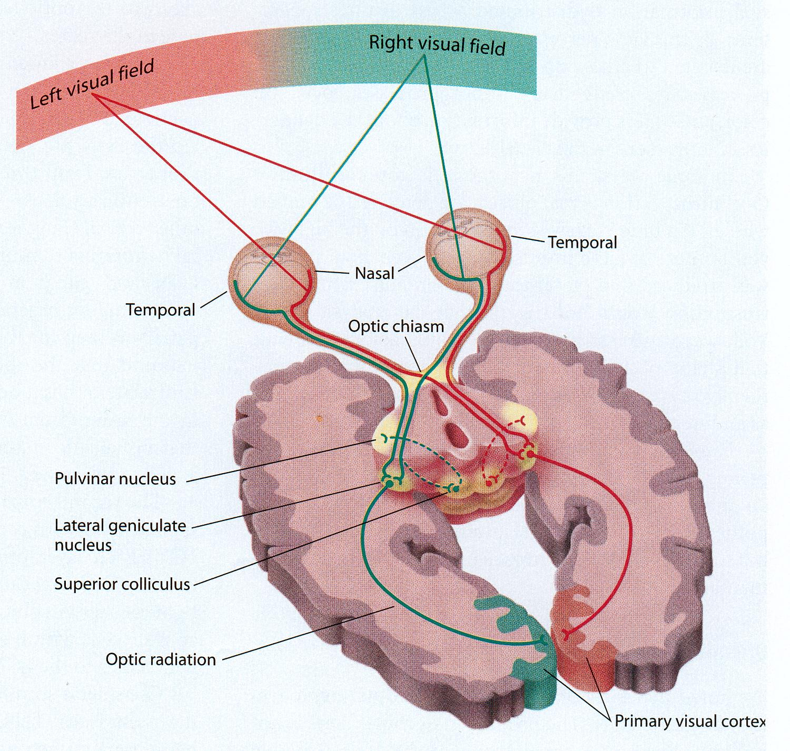
Visual Pathways
The visual pathway is the path of visual information from the eye, via neurons, to the visual cortex.

Slide 10
The Visual Pathways

Slide 11
The Visual Pathways
The thalamus is the gateway of primitive vision to the limbic system – a group of midbrain structures.
Thalamus is a sensory integrating system in part.
Integrates sight and sound for example, so when you hear something you know where to look. And routes signals to the proper areas.

Slide 12
The Visual Pathways
Thalamus sends signals to the reticular system, which is vigilant for significant stimuli in the environment.
Reticular means net-like.
Not a distinct lump, but a network of interconnecting neurons
The alerting of the reticular system that focuses our consciousness on something.

Slide 13
The Visual Pathways
Thalamus also sends signals to the septum, pleasure center of the brain.
Much richer connections to the septum in males.
Which is why males are so turned on by, er, certain visual images.
And females less so.

Slide 14
The Visual Pathways
Thalamus sends signals to the superior colliculus.
The superior colliculus is significant because, in rare cases where the signal does not get to the occipital cortex...
...people experience a phenomenon called blind vision.
They are not conscious of seeing anything, because the Occipital cortex is not receiving signals, but...
...they can walk through a room and not run into stuff.

Slide 15
The Visual Pathways
The signal passes through the thalamus and arrives at the primary visual cortex/occipital cortex.
That is the part of the cortex at the very back of your head.
When you get whacked on the back of the head, it causes neurons to fire that normally carry visual signals, and you see a flash of light

Slide 16
The Visual Pathways

Slide 17
At the Occipital Cortex
Now we are conscious of seeing something.
Sensation or perception?

Slide 18
At the Occipital Cortex
Sensation or perception?
It all depends…
…Knowledge, expectancy, motivation, emotion, attention, other factors.
Notes:
Knowledge, expectancy, motivation, emotion, attention, other factors.

Slide 19
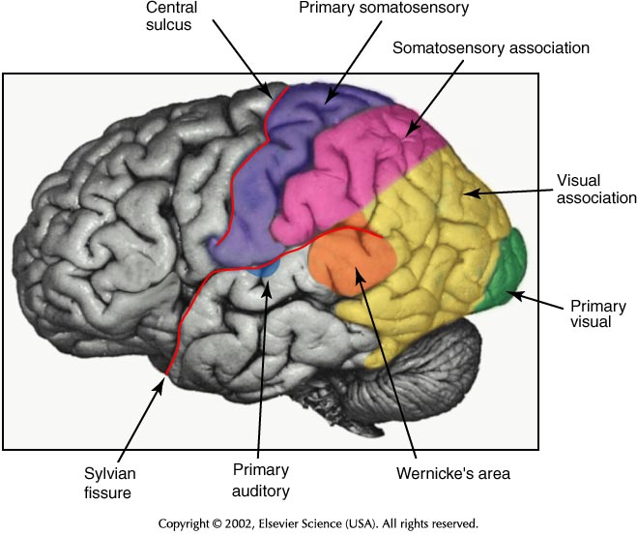
Information from long term memory.
Visual Information

Slide 20
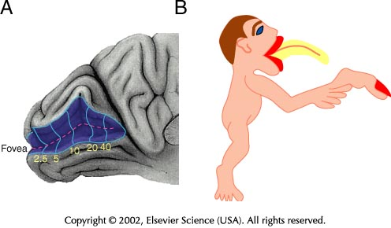
The fovea accounts for 25% of the primary visual cortex.

Slide 21
What & Where streams
Information flows along two pathways.
The dorsal stream, along the intraparietal sulcus, is concerned with localizing actions to spatial locations. This is the “where” stream.
The ventral stream goes to the inferior temporal lobe, is concerned with recognition of objects, including places and faces, & is the “what” stream.

Slide 22
Story Time!
Stories about perception…

