Slide 1
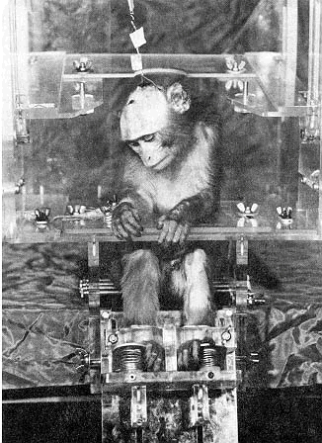
Stress
A. Kent Van Cleave, Jr., Ph.D.

Slide 2
Coping Resources / Response
Biological Stress Response
External
Situation
Personal
Interpretation
Figure 2. The Stress Chain

Slide 3
Overview
Stress Model – General Adaptation Syndrome
Sources of Stress
Coping With Stress
Some slides have been adapted from an unknown source

Slide 4
STRESS
Stress is the active state of tension that is created between an individual and his or her environment
…(internal or external)
…when the environment places demands on the individual that requires him or her to respond
…in order to maintain normal functioning.

Slide 5
THE GENERAL ADAPTATION SYNDROME
Selye proposed the GAS to help explain the short term effects of the body’s response to stressors and how too much prolonged stress can lead to illness.
The three stages of the GAS
Alarm Reaction – Stress response systems are activated – the pituitary gland produces ACTH and the adrenal medulla produces Adrenaline.
Resistance – The body adapts to cope with the stressor.
The organism is becoming susceptible to illness.
Exhaustion – If the body is put under prolonged stress its ability to cope starts to fail and exhaustion sets in.
May result in damaging the immune system and stress related illnesses become more likely.

Slide 6
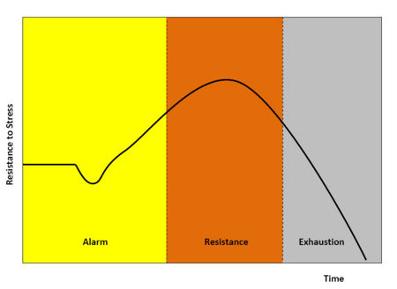
Resistance to Stress in the GAS

Slide 7
External
Demands & Pressures
Internal
Demands & Pressures
Individual
Interprets demands (perceptions)
Physiological Response
Sympathetic Nervous System
Endocrine
Glands
Strain
(Prolonged Response)
Susceptibility
Health habits
Lifestyle
Perception habits
Physical programming
Coping resources
Physical Symptoms
Figure 3. Biobehavioral Model

Slide 8
THE GENERAL ADAPTATION SYNDROME
Evaluation of the GAS
Seyle’s work was unethical, but it demonstrated a link between stress and illness.
His work was based on animals; only focused on the physiological response of stress.
Selye did later accept the importance of cognitive and emotional factors.
Individual differences…

Slide 9
STRESS AND PHYSICAL ILLNESS
Direct and indirect effects of stress on illness.
Direct Effects
Excessive levels of glucose and fatty acids in the blood increase the risk of cardiovascular disease by blocking the blood supply to the heart..
High blood pressure damages blood vessels and leads to clotting.
Excessive levels of cortisol release are related to arthritis.
Damage to the immune system by preventing the growth of T cells.

Slide 10
STRESS AND PHYSICAL ILLNESS
Direct and indirect effects of stress on illness.
Indirect Effects
Stress may lead people to behave in ways that increase their chances of becoming ill.
E.g. smoking, drinking, poor eating habits, lack of exercise.
Stress can also be responsible for people behaving in dangerous and unpredictable ways.
Cortisol increases our cravings for carbs and fat!
But not all stress is bad…

Slide 11
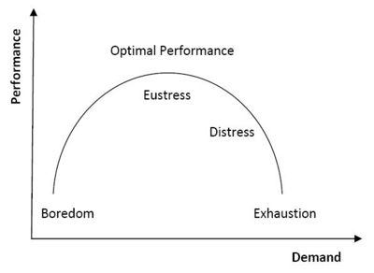
Stress-Performance Curve

Slide 12
Key Research studies into the relationship between stress and illness.
Williams – those who score high on the anger scale are more than twice as likely to have a heart attack asn those who do not score highly.
Krantz – CHD – reduced blood supply to the heart muscles.
Kiecolt-Glaser - Found that Immune system suppression is related to exam stress.
Holmes and Rahe - found that Life Changes are related to illness
Marmot – Stress at work – the job-strain model (high demand-low control theory).
Showed that civil servants on low grades (with little control) were more likely to develop heart attacks than those on higher grades).
Brady - Showed that monkeys with control were more likely to develop ulcers when given control of a lever.
Rodin & Langer showed that elderly people living in a home were happier and lived longer if they had some control over certain aspects of their lives (allowed visitors, having hobbies).
This suggests that personal control can reduce stress and improve health.

Slide 13
Stress at Work
Some aspect of a person’s job or workplace which produces a stress reaction in the body.
Noise, Temperature and crowding.
Those in jobs of higher grades developed fewer cardiovascular problems that those in low grade positions. Those in low position jobs are paid less, have less control, and have poorer social support networks.
Other factors:
Role ambiguity (lack of job description) or Overload
Poor relationships (with boss or colleagues)
Job insecurity (part time work/peace work/temporary employment/contract)
Shift work (leads to metabolism/body clock problems)
Perceived inadequacy & lack of recognition of achievement

Slide 14
Individual differences modify effects of stressors
Personality: Type A people are more at risk of developing CHD (Freidman & Rosenmann)
Culture: Those who live in collectivist cultures cope better with stressful situations. (Cooper)
Gender: During stressful situations, men show greater increases in blood pressure and stress hormones than women do. (Taylor)

Slide 15
STRESS MANAGEMENT
Stress management - different ways in which people try to cope with the negative effects of stress.
Commonly use physical methods to change the way our body reacts to stress,
…or psychological methods to change the way we deal with a stressful situation.
I propose a triune model based on the Intrapsychic Taxonomy (http://www.intrapsychictaxonomy.org)

Slide 16
Physical Remedies
Drugs
Benzodiazepines (Valium) increase production of GABA.
This chemical is the body’s natural form of anxiety relief.
Reduces serotonin activity. People who are anxious need high levels of GABA and low levels of serotonin to help make them less anxious.
Beta-blockers are used to slow down the heart rate and reduce blood pressure levels that otherwise could lead to serious problems for a person under stress.
A common drug for treatment of hypertension.
Sometimes used by sportspeople by reducing the arousal of the ANS which may hinder optimal performance.

Slide 17
Strengths & weaknesses
Drugs provide a short-term and quick remedy for stress.
They require little effort for the user and they are relatively cheap.
Drugs can also lead to addiction, side effects
…only treating the symptoms, not the problem

Slide 18
Biofeedback
Procedure:
The person is connected to the measuring device.
Instructed to focus on reducing specific stress responses.
Successful behaviours are repeated because they are rewarding.
The person learns to transfer his/her skills to everyday situations.

Slide 19
Biofeedback
Procedure:
The person is connected to the measuring device.
Instructed to focus on reducing specific stress responses.
Successful behaviours are repeated because they are rewarding.
The person learns to transfer his/her skills to everyday situations.

Slide 20
Psychological Remedies
Stress Inoculation Training (Meichenbaum)
Teach skills to cope with stress.
Conceptualization (Cognitive aspect)
Think about the problem and how it could be dealt with
Skills training practice (behavioral aspect)
Practice relaxation by using breathing exercises; talk about the problem; positive self-talk (telling yourself you can do it)
Application and Follow-up
Role-play , then apply the real world
Usually done in long-term therapy, which is expensive…
Something similar to SIT has been used extensively in the military to prepare soldiers against brainwashing if captured.

Slide 21
Hardiness training
Based on how stress-hardy individuals typically respond to stressors.
Teaches people better cognitive responses to stress.
-Recognize when about to be stressed or in stress
-Make realistic assessment of stress situation – including positive aspects
-Relate to experience – similar instances and how responded
-Choose response

Slide 22
Rational Emotive Therapy
Ellis -- Stress is caused by irrational thinking; leads a person to think of situations as a threat, and therefore stressful.
ABCDE Treatment:
A=actual event appraisal (I’ve failed my exam)
B=beliefs (because I’m lazy)
C=consequences of ‘B’ (I have to leave college)
Add the therapy
D=dispute the irrational beliefs
E=the Effect of ‘D’ is to restructure a persons beliefs about their ability

Slide 23
Control
Ability to anticipate when we are about to face a potentially stressful situation, to be prepared for it, and to have some control, real or imagined, over the situation.
Facilitating control:
Social support network of family and friends (men are less likely to do this as women).
Using information about a situation to give us a greater sense of control by putting things into perspective (not blowing things out of proportion, being rational).
Using a belief system such as religion which may give a person a sense of security and stability.
Changing a behaviour to help cope better with a situation (worrying less about not passing exams by being more enthusiastic and motivated towards studying).

Slide 24
Locus of control
Locus of control describes the focus of people’s sense of control in their lives.
People who believe they have control over their successes and failures are described as having an internal locus of control.
Those of us who believe that our lives are determined by outside influences such as believing in luck or fate are described are described as having an external locus of control.
Most of us are somewhere in the middle of the two.
Learned helplessness suggests that people who have had lots of bad experiences in life become apathetic towards certain situations.
This is a characteristic of many people who are depressed.
Depressed people believe that they are worthless, that life is awful and that there is no future for them.
Beck’s cognitive triad attempts to change the way people think about their lives by cognitive restructuring training.
BUT – If we believe we have control, is it more stressful than believing we have none?

Slide 25
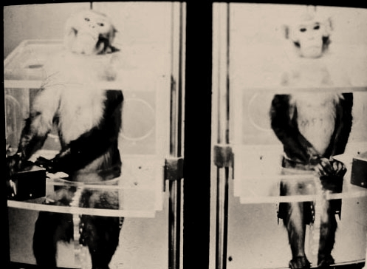
Brady’s ‘executive’ monkey study
Paired monkeys received electric shock every 20 seconds on a six hours on and six hours off schedule.
Half (right) had no control over the shocks.
Half (left) had control – could avoid some shocks by pressing a button.
The monkeys with the button suffered from gastric ulcers, and some died.
The monkeys with no button were not negatively affected.
Partial control was more stressful than no control.

